Slide 1
7N India

Slide 2
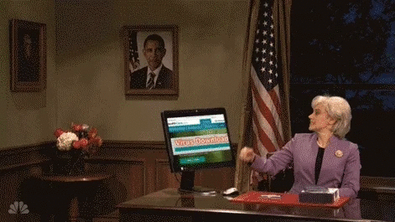

Slide 3


Slide 4
HttpInterceptor Interface
ErrorHandler Class
Server Side Errors
ErrorHandler Class
Client Side Errors
Global Error Handling in Angular

Slide 5
Error Handler Class
Create a service.
Implement your own handleError method, distinguish between the front end and backend error and take the appropriate action .
Configure this new service to handle errors.

Slide 6
HttpInterceptor Interface
Create a service.
Implement the HttpInterceptor interface.
Implement intercept method.
Configure this new service to intercept your backend calls.

Slide 7


Slide 8
Thank you

